Slide 1
Scam Awareness
Presented by: Eve Curran
17 September 2021

Slide 2
Anyone
can be affected
by scams
53%
of victims are
over 55
Only 5%
of scams are
reported
€1,005
average sum of money stolen in Ireland by fraudsters
Notes:
Size of the current problem
Criminals don’t really care who they target
2

Slide 3
Types of scams
1
2
3
4
Postal scams
Telephone scams
Doorstep scams
Online scams
Have you ever been involved in one of these Scams?
Notes:
Postal Scam Examples
Lottery/Prize draw, Inheritance Scam, Clairvoyant Scam, Catalogue Scam
Telephone Scam Examples
Phone calls, Unusual payments, SMS messages, Computer/Broadband fault, “Helpful caller”
Opportunities, “Something wrong at the Bank”
Doorstep Scam Examples
Rogue Traders, Distraction burglary, Unnecessary/poor work
Fearful, Pressure, Cash withdrawals, Sometimes money up front, Works extended/follow up visit more costs
Online Scam Examples
Suspicious emails, Final demands, Refunds, Online relationship, Helping a friend out, Payments, Impersonating Officials (e.g Guards)
Can be very targeted (Phishing) and in line with current news/affairs
3

Slide 4
How the cycle works
Victim responds to scam
Personal details
added to a victims’ list
Victim loses money
Victim receives more scams
approaches
Criminals target the
victim
Notes:
Victim may have had previous email or pone call
Is there a reason for this – yes scams seldom happen in isolation
4

Slide 5
Scams are the product of organised, predatory criminals… …who gain trust to exploit and steal money
Befriending and grooming techniques
Appear legitimate
Helpful
Persuasive
Persistent
Friendly
Charming
Threatening
Aggressive
Intimidating
Notes:
Denise – Becoming increasingly difficult for customers
Joe – Simple grooming techniques
5

Slide 6
Common scams impacting younger generation
Identity Theft
Money Mules
Fake Job Adverts
Notes:
Identity Theft
Fraudsters collect their victims personal information from social media, hacking, stealing mail and from personal information you unknowingly provide
This information is used to apply for loans etc in the victims name
You may not realise anything has happened until an unexpected bill arrives
Check your privacy settings & protect your information
Money Mules
A “Money Mule” is where someone's bank account is used to launder the proceeds of crime
The criminal gangs behind these frauds are highly organised, persistent and determined
Social Media is often used to recruit young Money Mules with a payment made to allow their bank account to be used
It’s a crime
Fake Job Adverts
Jobs which offer good money for very little work
Often the job adverts are posted online or on social media
Can ask you for fees upfront for training/other expenses
Over pay you and then ask you to return the overpayment and the original payment “bounces” leaving you out of pocked
6

Slide 7
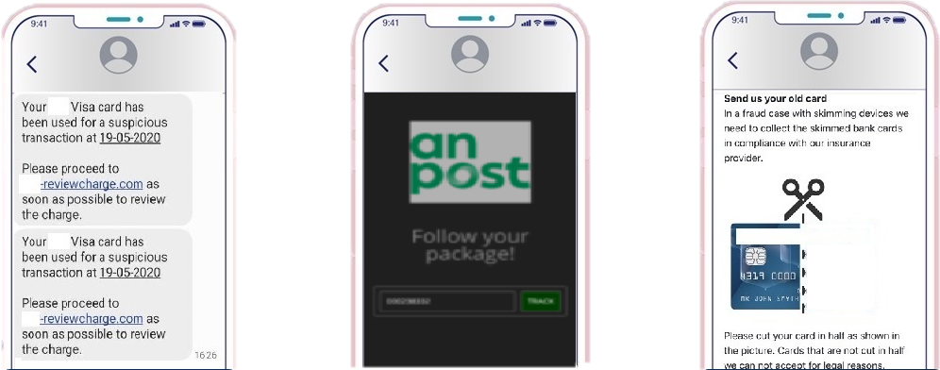
Text/Email Scams
Notes:
We have some live examples – personal information & bank details
7

Slide 8
Top Tips
Never give remote access to your laptop or home computer
Always verify the caller using an independently verified telephone number such as one from our website / back of your bank card
The bank or police will never ask you to move your money to a ‘safe account’.
You will never receive a genuine call to tell you your Wi-Fi or internet is slow
Notes:
Joe – what would you say to people in order to protect themselves from this type of scam
8

Slide 9
Top Tips
Be extra careful if you receive any phone calls, texts or emails from anyone claiming to be a bank or other trusted organisation. A genuine bank or organisation will never contact you out of the blue to ask for your PIN, full password, card reader codes, passcodes, or to move money to another account. Personal information is yours. Don’t give it away.
Never click on a link received in an email or text that then takes you to a website requesting personal information or login details. Always go via a search engine or direct to the company website.
Never allow remote access to your computer by any third party. Scammers will often ask you to download an app or will send you email with a link such as Team Viewer.
Watch out for poor grammar or spelling on emails/printed material/letters.
Stop and think about what you are being asked to do. If concerned, stop and talk to your family or a friend.
Notes:
Joe – Before we open to questions, Denise do you want to just share your top tips
9

Slide 10
Help & Support
Ulster Bank Security Centre
Friends Against Scams video
If you think you’ve been a victim, contact your bank in the first instance
Ulster Bank Customers – Download Malwarebytes Premium
Talk – You are not alone and shouldn’t feel embarrassed
Notes:
Joe – If you want to read up on more ways people can protect themselves.
10

Slide 11
Questions & Answers

